Slide 1
Microsoft Stocks Analysis
An Interactive Power BI Dashboard for Analyzing Stock Data

Slide 2
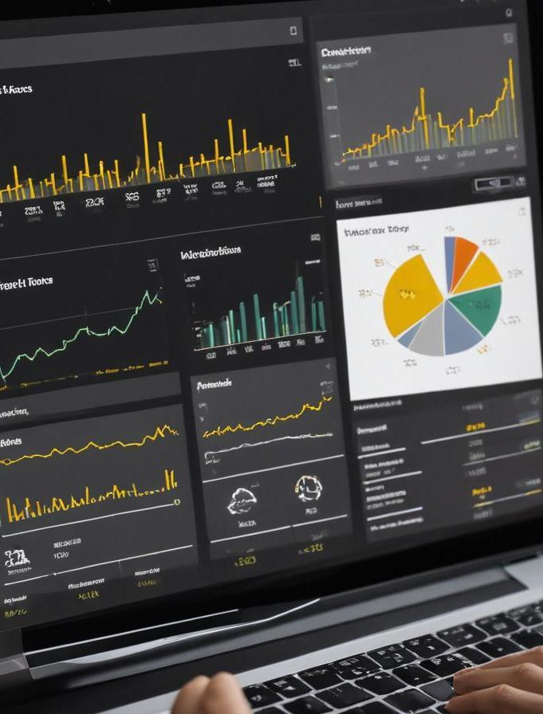
Introduction
This presentation showcases an interactive Power BI dashboard that tracks key metrics for Microsoft stocks. It enables users to analyze stock prices, volume, and daily performance, providing insights for data-driven decision-making in financial analysis.

Slide 3
01
Dashboard Overview

Slide 4
Key metrics tracked
The dashboard monitors crucial metrics such as live stock prices, trading volume, daily high and low prices, and adjusted close values. These metrics provide users with a comprehensive understanding of market performance and are essential for making informed trading decisions.

Slide 5

Dashboard interactivity
Users can interact with the dashboard by filtering data, selecting date ranges, and drilling down into specific stock performance metrics. This interactivity allows for personalized analysis and facilitates a deeper understanding of the trends and patterns in Microsoft's stock data.

Slide 6
User exploration features
The dashboard includes features that allow users to drill down into specific timeframes, select different metrics, and compare various stock data points. This functionality enhances user engagement and provides tailored insights based on individual analysis requirements.

Slide 7
02
Data Insights

Slide 8
Trend analysis
Utilizing historical stock data, users can visualize trends over time, identifying patterns in stock performance, seasonal variations, and market reactions to external events. This analysis is crucial for predicting future movements and making informed investment decisions.

Slide 9
Volume fluctuations
The dashboard tracks trading volume variations, providing insights into market activity levels. Increased volume often indicates strong sentiment or reaction to news, while low volume may suggest indecision. Understanding these fluctuations helps in assessing market strength and trends.

Slide 10
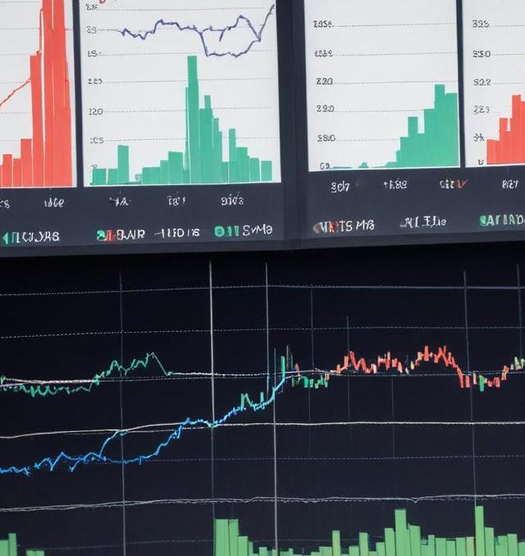
Historical data comparison
Users can compare current stock data against historical performance metrics to assess growth, volatility, and overall progress. This feature is essential for understanding how Microsoft's stock has reacted over different time periods and economic conditions, thereby aiding in strategic planning.

Slide 11

Conclusions
The Microsoft Stocks Analysis dashboard provides an interactive platform for exploring critical stock metrics. By leveraging key insights, users can make informed financial decisions based on comprehensive trend analysis, volume assessment, and historical comparisons.

Slide 12
Thank you!
Do you have any questions?
+91 620 421 838

